Slide 1

Global Banking Fraud Detection & Risk Analysis
An end-to-end data analytics case study using Excel, SQL, and Power BI
Garv Dudy
Data Analyst Project | December 2025

Slide 2
Executive Summary
Modern banking systems process millions of transactions daily, making it increasingly difficult to detect fraud early without data-driven monitoring. This project analyzes a large-scale banking transaction dataset to uncover transaction behavior, risk exposure, and fraud patterns using an end-to-end analytics pipeline.
Key Highlights:
Analyzed 153,000 + banking Transactions
Built a full pipeline from Excel → SQL → Power BI
Identified fraud concentration, risk signals, and spending behavior
Delivered executive-level and analyst-level dashboards for decision making.

Slide 3
Business Problem
Banks face a critical challenge: high Transactions volume increases fraud risk, but manual monitoring cannot scale. Fraud often represents a small percentage of total transactions, yet even a minor increase can lead to significant financial losses and reputational damage.
Key Challenges Addressed:
Detecting Fraud Hidden within large transaction volumes
Understanding risk beyond confirm fraud
Identifying high-risk merchants, regions, and channels
Supporting early intervention, not just reactive controls

Slide 4
Project Objectives
This project aims to move beyond simple fraud counts and instead analyze transaction behavior holistically to support smarter banking decisions.
Objectives:
Analyze transaction volume and monetary flow across the system
Measure Fraud rate and transaction risk exposure
Identify high-risk merchant categories and transaction types
Build Dashboards that support executives, risk teams and analysts

Slide 5
Data Overview
The Dataset represents realistic banking transaction behavior over multiple years and channels, enabling deep behavioral analysis.
Dataset Characteristics:
153000+ Transactions Records
Time-based data (year, quarter, month)
Merchant categories and transaction channels
Geographic indicators (countries/regions)
Risk Score and Fraud Flag indicators

Slide 6
Methodology (end-to-end Pipeline)
To Ensure scalability and realism, the project follows a structured analytics pipeline like real banking environments.
Workflow:
Excel: Data cleaning, formatting, and preparation
SQL: Querying, Aggregations, fraud analysis, and KPI calculations
Power BI: Interactive dashboards and storytelling visuals
This Layered approach ensures accuracy, performance, and clarity.

Slide 7
Data Cleaning & Preparation (Excel)
Raw Transactional data often contains inconsistencies that can distort analysis. Significant effort was invested in preparing the dataset for reliable analytics.
Cleaning steps performed:
Standardized column formats and naming conventions
Handled missing and inconsistent values
Split and normalized columns for SQL compatibility
Optimized structure for Power BI modeling
Result: A clean, analysis-read dataset suitable for scalable querying and visualizations.

Slide 8
SQL Analysis Layer
SQL acted as the analytical engine of this project, transforming cleaned transactional data into structured insights before visualization. Rather than pushing raw data directly into Power BI, SQL was used to validate trends, calculate risk metrics, and isolate fraud behavior, ensuring analytical accuracy and scalability.
Through SQL, this project replicated how banks typically analyze transaction data at the backend level before exposing results to dashboards.
Key SQL analysis performed.
Aggregation Transaction volume and Total monetary flow
Calculated Fraud rate and avg risk score
Identified high-risk Merchant category and Transaction type
Time-series trend extraction
This layer ensure accurate KPIs and reusable logic before visualization.

Slide 9
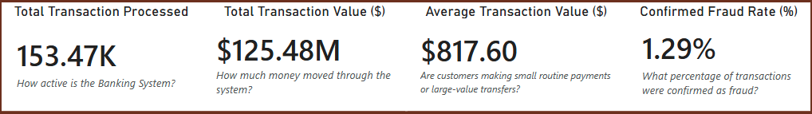
Key Performance Indicators (KPIs)
These KIPs act as an early-warning system for banking risk. Rather than isolating fraud alone, they measure transaction intensity, monetary exposure, and behavioral risk simultaneously, enabling precative intervention.
Together, these indicators answer four critical questions:
Total Transaction flow reflects system activity & scale
Fraud rate highlights hidden risk within normal transactions
Average fraud transaction value signals financial impact severity

Slide 10
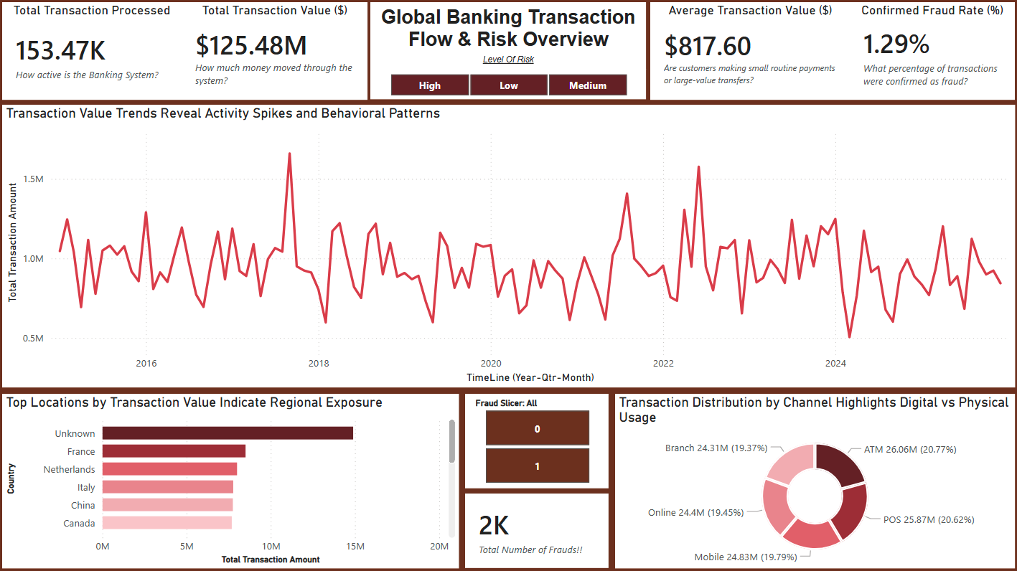
Global Banking Transaction Flow & Risk Overview
What this dashboard answers:
How active is the global banking system overtime?
  System was active with an average of 1M Transaction Each Month, except some outliers.
Where is money concentrated geographically?
  Most amount is transferred from unknow country with 14M+ and France holding 2nd with 8.5M+, then most of the countries having 7M in avg spending. India as last in list with 6.5M Transaction
How are customers transacting (digital vs physical)?
  Well customers preferring Digital transactions (Mobile + POS + Online) which is 75M+ in Total more then Physical with only 50M+ Transfers (ATM + Branch Visit).
What is the overall fraud exposure?
  There is in total of 2K Frauds with 18.65M of Money and most important think to note is the Average spending which comes out to be $9.45K each Transaction in case of fraud, whereas the normal Avg spending is around $800
  Canada is the 2nd Know country for fraud transaction after Unknow with 1.6M+ total in money.

Slide 11
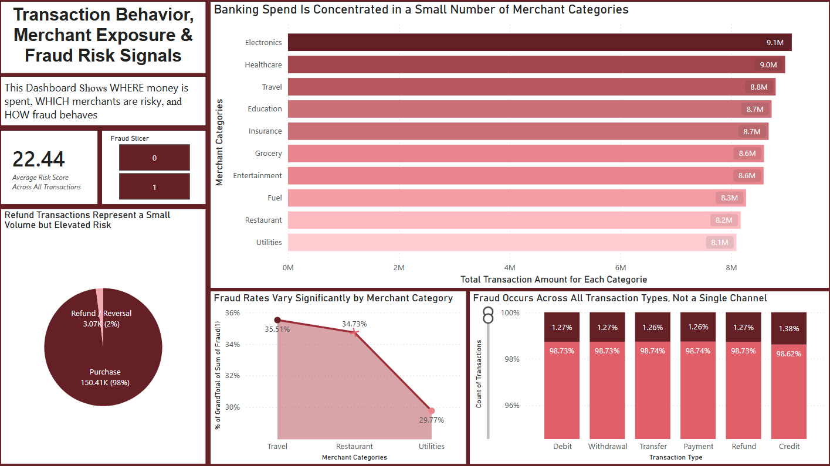
Transaction Behavior, Merchant Exposure & Fraud Risk Signals
What this dashboard reveals:
While merchant categories dominate spending
  Money spent on electronics is the highest among all with 9.1M+, Healthcare has a total of 9.0M+ spend. One major think to notice is they all have similar spending amount.
Where fraud rates vary significantly by category
  Approx 1.65M+ was detected as fraud in restaurants, Education holds a total of 1.55M+ in fraud whereas Online Retail is the lest spent in fraud.
  Transaction detected as fraud in Entertainment, Healthcare and ATM withdrawal are nearly equivalent to each other.
How refunds and reversals differ in risk behavior
  In total There was 2% of Refund/Reversal which makes 3.07K in numbers. Whereas confirmed purchase was 150.41K in total.
  For Fraud Refund there was only 0.05K whereas for Fraud purchase it’s 1.93K
Whether fraud is concentrated or distributed across transaction types
  In shot all Transaction Type Faced fraud equally, but zooming in gives us that credit was used slightly more with approx 0.11% in frauds then any other means.

Slide 12
Key Findings and Strategic Recommendations
Key Findings:
The analysis reveals that banking fraud is not driven by transaction volume alone but emerges from behavioral patterns across merchant categories, transaction intent, and refund activity. While the overall fraud rate remains low, its financial impact and distribution highlight the need for proactive risk monitoring rather than reactive controls.
However, Fraud Rate remains low overall (~1.29%) but is persistent and makes a total of 18.65M in Transaction Amount.
Risk is destituted across all transaction types
Certain merchant categories exhibit elevated fraud rates
Refund transactions show higher relative risk despite low volume
High Transaction Value does not always correlate with fraud
Strategic Recommendations:
Implement behavior-based risk scoring, not value-based flags
Increase monitoring on refund and reversal patterns
Prioritize merchant category risk profiling
Shift fraud detection from reactive alerts → predictive signals

Slide 13
Conclusion
This project demonstrates how an end-to-end analytics pipeline can convert large-scale transactional data into actionable banking intelligence. By integrating Excel, SQL, and Power BI, the analysis moves from raw data to executive insight in a structured, scalable way.
Final Outcomes achieved:
Studied and analyze the data using analytical thinking.
Cleaned Data with best practice in Excel
Using SQL queried the data before moving to visualize it
Created pipelines between three top software
Built a realistic banking analytics pipeline
Delivered executive and analyst-focused dashboards
Identified fraud patterns and behavioral risk signals
Created a framework applicable to real world banks

